Slide 1
Data Scraping in Python
Nicholas Mattei, Tulane University
CMPS3660 – Introduction to Data Science – Fall 2019
https://rebrand.ly/TUDataScience
Many Thanks
Slides based off Introduction to Data Science from John P. Dickerson - https://cmsc320.github.io/

Slide 2
Announcements
Reminder: Lab 1 + 2 Due at End of Day
Go over Questions 2
John has an announcement!

Slide 3
The Data LifeCycle
Data Collection
Data Processing
Exploratory Analysis
&
Data Visualization
Analysis, Hypothesis Testing,
& ML
Insight
&
Policy Decision
Today

Slide 4
GotTa Catch ‘Em All
Five ways to get data:
Direct download and load from local storage
Generate locally via downloaded code (e.g., simulation)
Query data from a database (covered in a few lectures)
Query an API from the intra/internet
Scrape data from a webpage
Covered today.

Slide 5
Wherefore art thou, API?
A web-based Application Programming Interface (API) like we’ll be using in this class is a contract between a server and a user stating:
“If you send me a specific request, I will return some information in a structured and documented format.”
More generally, APIs can also perform actions, may not be web-based, be a set of protocols for communicating between processes, between an application and an OS, etc.
We’re going to use the Python requests module.
Documentation: https://2.python-requests.org/en/master/user/quickstart/
Notes:
”Wherefore” means “why”, not “where”!

Slide 6
“Send me a specific request”
Most web API queries we’ll be doing will use HTTP requests:
conda install anaconda requests
r = requests.get('https://api.github.com/users/nmattei')
r.status_code
200
r.headers[‘content-type’]
‘application/json; charset=utf8’
r.json()
{{'login': 'nmattei', 'id': 1206578, …}
http://docs.python-requests.org/en/master/

Slide 7
HTTP Requests – How the Browser Does It.
https://www.google.com/search?q=%27tulane%20university%27
HTTP GET Request:
GET /search? q=%27tulane%20university%27
Host: www.google.com/search
User-Agent: Mozilla/5.0 (X11; Linux x86_64; rv:10.0.1) Gecko/20100101 Firefox/10.0.1
??????????
params = { “q”: “tulane university”}
r = requests.get(“https://www.google.com/search”, params = params )
*be careful with https:// calls; requests will not verify SSL by default

Slide 8
Restful APIs
This class will just query web APIs, but full web APIs typically allow more.
Representational State Transfer (RESTful) APIs:
GET: perform query, return data
POST: create a new entry or object
PUT: update an existing entry or object
DELETE: delete an existing entry or object
Can be more intricate, but verbs (“put”) align with actions
Good example: The ITunes API
https://affiliate.itunes.apple.com/resources/documentation/itunes-store-web-service-search-api/

Slide 9
Querying a Restful API
Stateless: with every request, you send along a token/authentication of who you are
GitHub is more than a GETHub:
PUT/POST/DELETE can edit your repositories, etc.
Try it out: https://github.com/settings/tokens/new
token = ”super_secret_token”
r = requests.get(“https://github.com/users”,
params={”access_token”: token})
print( r.content )
{"login":”nmattei","id":472985,"avatar_url":"ht…

Slide 10
Authentication and OAuth
Old and busted:
New hotness:
What if I wanted to grant an app access to, e.g., my Facebook account without giving that app my password?
OAuth: grants access tokens that give (possibly incomplete) access to a user or app without exposing a password
These can get complicated and are site specific.. Some examples below.
https://developers.facebook.com/docs/facebook-login/access-tokens/
https://developer.spotify.com/documentation/general/guides/authorization-guide/
r = requests.get(“https://api.github.com/user”,
auth=(“nmattei”, “ILoveKittens”))

Slide 11
Example OAuth: Spotify

Slide 12
“… I will return information in a structured format.”
So we’ve queried a server using a well-formed GET request via the requests Python module. What comes back?
General structured data:
Comma-Separated Value (CSV) files & strings
Javascript Object Notation (JSON) files & strings
HTML, XHTML, XML files & strings
Domain-specific structured data:
Shapefiles: geospatial vector data (OpenStreetMap)
RVT files: architectural planning (Autodesk Revit)
You can make up your own! Always document it.

Slide 13
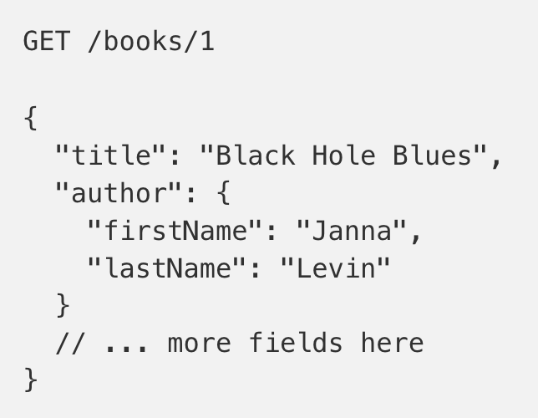
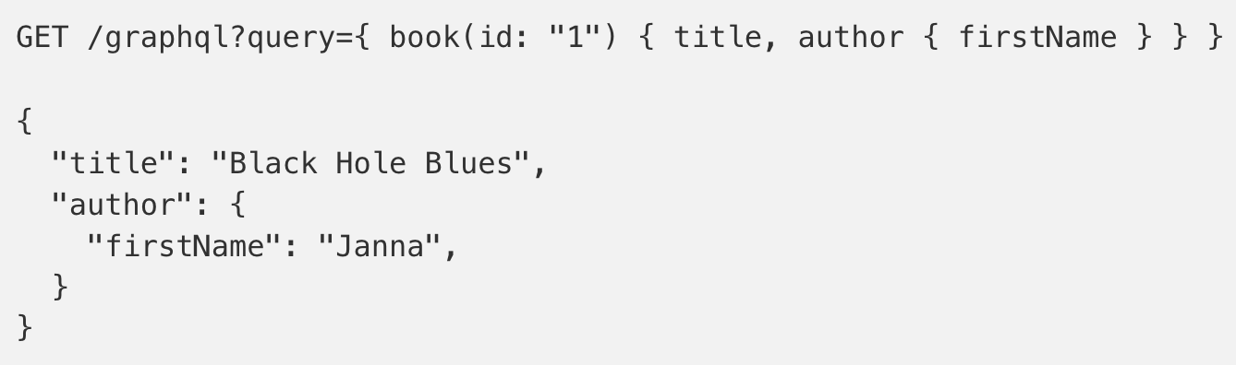
GraphQL?
An alternative to REST and ad-hoc webservice architectures
Developed internally by Facebook and released publicly
Unlike REST, the requester specifies the format of the response
https://dev-blog.apollodata.com/graphql-vs-rest-5d425123e34b

Slide 14
CSV Files in Python
Any CSV reader worth anything can parse files with any delimiter, not just a comma (e.g., “TSV” for tab-separated)
1,26-Jan,Introduction,—,"pdf, pptx",Dickerson, 2,31-Jan,Scraping Data with Python,Anaconda's Test Drive.,,Dickerson, 3,2-Feb,"Vectors, Matrices, and Dataframes",Introduction to pandas.,,Dickerson, 4,7-Feb,Jupyter notebook lab,,,"Denis, Anant, & Neil", 5,9-Feb,Best Practices for Data Science Projects,,,Dickerson,
Don’t write your own CSV or JSON parser
(We’ll use pandas to do this much more easily and efficiently)
import csv
with open(“schedule.csv”, ”rb”) as f:
reader = csv.reader(f, delimiter=“,”, quotechar=’”’)
for row in reader:
print(row)

Slide 15
JSON Files & Strings
Python dictionary, Java Map, hash table, etc …
JSON is a method for serializing objects:
Convert an object into a string (done in Java in 131/132?)
Deserialization converts a string back to an object
Easy for humans to read (and sanity check, edit)
Defined by three universal data structures
Python list, Java array, vector, etc …
Python string, float, int, boolean, JSON object, JSON array, …
Images from: http://www.json.org/

Slide 16
JSON In Python
Some built-in types: “Strings”, 1.0, True, False, None
Lists: [“Goodbye”, “Cruel”, “World”]
Dictionaries: {“hello”: “bonjour”, “goodbye”, “au revoir”}
Dictionaries within lists within dictionaries within lists:
[1, 2, {“Help”:[ “I’m”, {“trapped”: “in”}, “CMSC320” ]}]

Slide 17
JSON From ITunes API
GET https://itunes.apple.com/search?term=the%2Bmeters&entity=album
{ 'resultCount': 15,
'results’: [
{'wrapperType': 'collection’,
'collectionType': 'Album’,
'artistId': 7314214,
'collectionId': 213532006,
'amgArtistId': 4907,
'artistName': 'The Meters’,
'collectionName': 'The Very Best of the Meters’,
'collectionCensoredName': 'The Very Best of the Meters’,
…

Slide 18
Parsing JSON In Python
Repeat: don’t write your own CSV or JSON parser
https://news.ycombinator.com/item?id=7796268
https://rsdy.github.io/posts/dont_write_your_json_parser_plz.html
Python comes with a fine JSON parser – USE IT!
import json
r = requests.get(‘https://itunes.apple.com/search?term=the%2Bmeters&entity=album’)
data = json.loads(r.content)
json.load(some_file) # loads JSON from a file
json.dump(json_obj, some_file) # writes JSON to file
json.dumps(json_obj) # returns JSON string

Slide 19
XML, XHTML, HTML files and Strings
Still hugely popular online, but JSON has essentially replaced XML for:
Asynchronous browser ←→ server calls
Many (most?) newer web APIs
XML is a hierarchical markup language:
<tag attribute=“value1”> <subtag> Some content goes here </subtag> <openclosetag attribute=“value2” /> </tag>
You probably won’t see much XML, but you will see plenty of HTML, its substantially less well-behaved cousin …
Example XML from: Zico Kolter

Slide 20
Document Object Model (DOM)
XML encodes Document-Object Models (“the DOM”)
The DOM is tree-structured.
Easy to work with! Everything is encoded via links.
Can be huge, & mostly full of stuff you don’t need …

Slide 21
Scraping HTML in Python
HTML – the specification – is fairly pure
HTML – what you find on the web – is horrifying
Getting better with automated generation -- https://tulaneintrodatascience.github.io/
We’ll use BeautifulSoup:
conda install -c beautifulsoup4
import requests
from bs4 import BeautifulSoup
r = requests.get(“https://tulaneintrodatascience.github.io/”)
root = BeautifulSoup( r.content )
root.find(“table”) # Find a the tables.
root.find(“tbody”).findAll(“a”) # links in that table.

Slide 22
Building a Web Scraper in Python
Totally not hypothetical situation:
You really want to learn about data science, so you choose to download all of the lecture slides to wallpaper your room …
… but you now have carpal tunnel syndrome from clicking refresh on Piazza last night, and can no longer click on the PDF links.
Hopeless? No! Earlier, you built a scraper to do this!
Sort of. You only want PDF and PPTX files, not links to other websites or files.
lnks = root.find("table").findAll("a") # links within the table.

Slide 23
Detour: Regular Expressions
Given a list of URLs (strings), how do I find only those strings that end in *.pdf?
Regular expressions!
(Actually Python strings come with a built-in endswith function.)
What about .pDf or .pPTx, still legal extensions for PDF/PPTX?
Regular expressions!
(Or cheat the system again: built-in string lower function.)
“this_is_a_filename.pdf”.endswith((“.pdf”, “.pptx”))
“tHiS_IS_a_FileNAme.pDF”.lower().endswith((“.pdf”, “.pptx”))

Slide 24
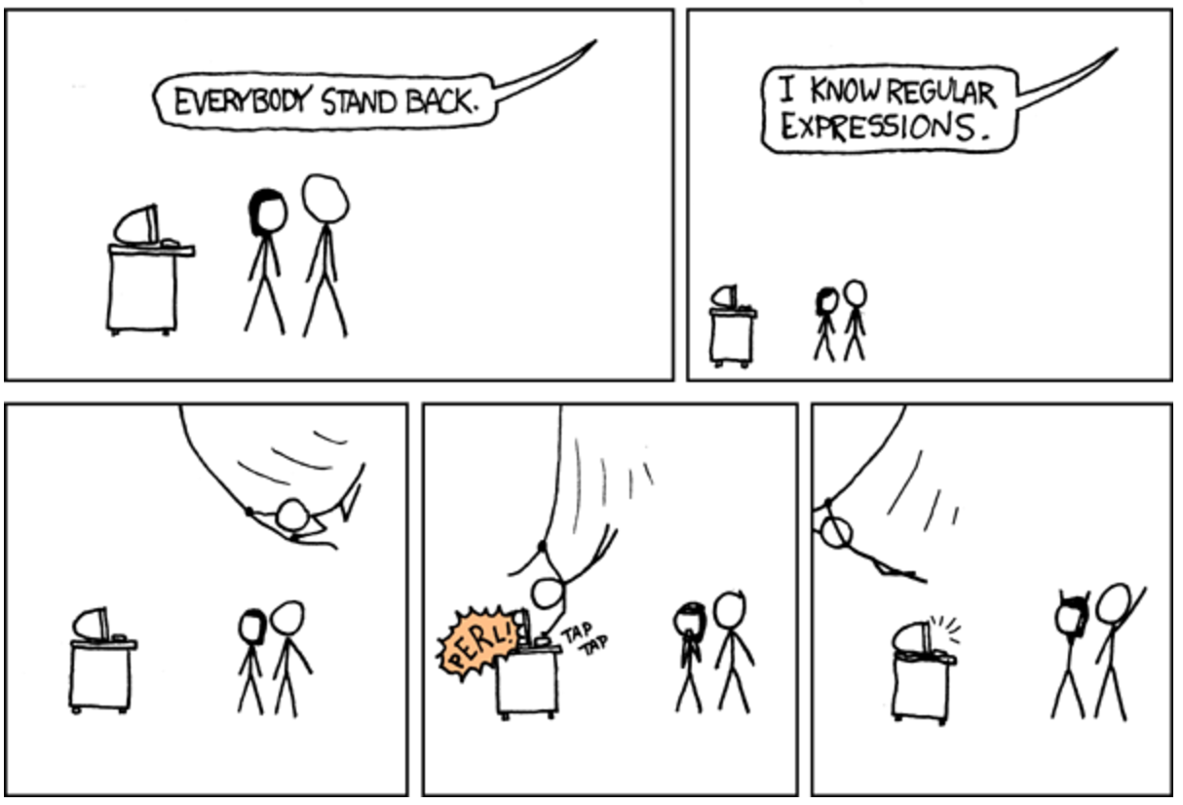

Slide 25
Regular Expressions
Used to search for specific elements, or groups of elements, that match a pattern
Indispensable for data munging and wrangling
Many constructs to search a variety of different patterns
Many languages/libraries (including Python) allow “compiling”
Much faster for repeated applications of the regex pattern
https://blog.codinghorror.com/to-compile-or-not-to-compile/
Intro Tutorial from Python: https://docs.python.org/3/howto/regex.html

Slide 26
Regular Expressions
The r is for ‘raw string’ and it’s very important…
https://stackoverflow.com/questions/21104476/what-does-the-r-in-pythons-re-compiler-pattern-flags-mean
Used to search for specific elements, or groups of elements, that match a pattern
import re
# Find the index of the 1st occurrence of “CMPS 3660”
match = re.search(r”CMPS 3660”, text)
print( match.start() )
# Does start of text match “CMPS 3660”?
match = re.match(r”CMPS 3660”, text)
# Iterate over all matches for “CMPS 3660” in text
for match in re.finditer(r”cmsc320”, text):
print( match.start() )
# Return all matches of “CMPS 3660” in the text
match = re.findall(r”cmsc320”, text)

Slide 27
Matching Multiple Characters
Can match sets of characters, or multiple and more elaborate sets and sequences of characters:
Match the character ‘a’: a
Match the character ‘a’, ‘b’, or ‘c’: [abc]
Match any character except ‘a’, ‘b’, or ‘c’: [^abc]
Match any digit: \d (= [0123456789] or [0-9])
Match any alphanumeric: \w (= [a-zA-Z0-9_])
Match any whitespace: \s (= [ \t\n\r\f\v])
Match any character: .
Special characters must be escaped: .^$*+?{}\[]|()
Thanks to: Zico Kolter

Slide 28
Matching Sequences and Repeated Characters
A few common modifiers (available in Python and most high-level languages; +, {n}, {n,} may not):
Match character ‘a’ exactly once: a
Match character ‘a’ zero or once: a?
Match character ‘a’ zero or more times: a*
Match character ‘a’ one or more times: a+
Match character ‘a’ exactly n times: a{n}
Match character ‘a’ at least n times: a{n,}
Useful to keep a tester around: http://www.pyregex.com/

Slide 29
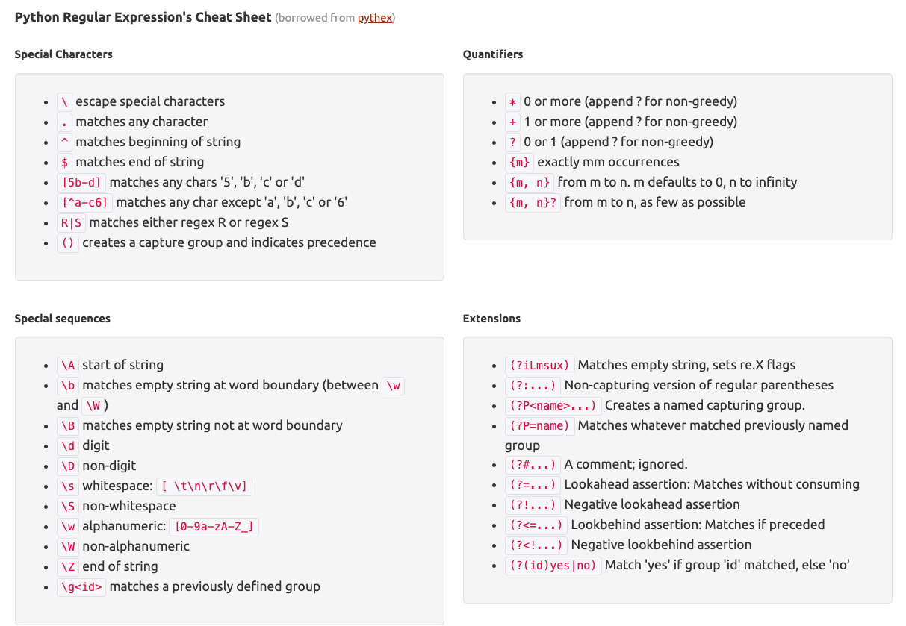
Cheat Sheet
Example: match all instances of: “University of <somewhere>” where: <somewhere> is an alphanumeric string with at least 3 characters:
\s*University\sof\s\w{3,}

Slide 30
Groups
What if we want to know more than just:
“did we find a match” or
“where is the first match” …?
Grouping asks the regex matcher to keep track of certain portions – surrounded by (parentheses) – of the match
\s*([Uu]niversity)\s([Oo]f)\s(\w{3,})
regex = r”\s*([Uu]niversity)\s([Oo]f)\s(\w{3,})”
m = re.search( regex, “university Of Kentucky” )
print( m.groups() )
('university', 'Of', ‘Kentucky')

Slide 31
Simple Example: Parse an Email Address
(?:(?:\r\n)?[ \t])*(?:(?:(?:[^()<>@,;:\\".\[\] \000-\031]+(?:(?:(?:\r\n)?[ \t] )+|\Z|(?=[\["()<>@,;:\\".\[\]]))|"(?:[^\"\r\\]|\\.|(?:(?:\r\n)?[ \t]))*"(?:(?: \r\n)?[ \t])*)(?:\.(?:(?:\r\n)?[ \t])*(?:[^()<>@,;:\\".\[\] \000-\031]+(?:(?:( ?:\r\n)?[ \t])+|\Z|(?=[\["()<>@,;:\\".\[\]]))|"(?:[^\"\r\\]|\\.|(?:(?:\r\n)?[ \t]))*"(?:(?:\r\n)?[ \t])*))*@(?:(?:\r\n)?[ \t])*(?:[^()<>@,;:\\".\[\] \000-\0 31]+(?:(?:(?:\r\n)?[ \t])+|\Z|(?=[\["()<>@,;:\\".\[\]]))|\[([^\[\]\r\\]|\\.)*\ ](?:(?:\r\n)?[ \t])*)(?:\.(?:(?:\r\n)?[ \t])*(?:[^()<>@,;:\\".\[\] \000-\031]+ (?:(?:(?:\r\n)?[ \t])+|\Z|(?=[\["()<>@,;:\\".\[\]]))|\[([^\[\]\r\\]|\\.)*\](?: (?:\r\n)?[ \t])*))*|(?:[^()<>@,;:\\".\[\] \000-\031]+(?:(?:(?:\r\n)?[ \t])+|\Z |(?=[\["()<>@,;:\\".\[\]]))|"(?:[^\"\r\\]|\\.|(?:(?:\r\n)?[ \t]))*"(?:(?:\r\n) ?[ \t])*)*\<(?:(?:\r\n)?[ \t])*(?:@(?:[^()<>@,;:\\".\[\] \000-\031]+(?:(?:(?:\ r\n)?[ \t])+|\Z|(?=[\["()<>@,;:\\".\[\]]))|\[([^\[\]\r\\]|\\.)*\](?:(?:\r\n)?[ \t])*)(?:\.(?:(?:\r\n)?[ \t])*(?:[^()<>@,;:\\".\[\] \000-\031]+(?:(?:(?:\r\n) ?[ \t])+|\Z|(?=[\["()<>@,;:\\".\[\]]))|\[([^\[\]\r\\]|\\.)*\](?:(?:\r\n)?[ \t] )*))*(?:,@(?:(?:\r\n)?[ \t])*(?:[^()<>@,;:\\".\[\] \000-\031]+(?:(?:(?:\r\n)?[ \t])+|\Z|(?=[\["()<>@,;:\\".\[\]]))|\[([^\[\]\r\\]|\\.)*\](?:(?:\r\n)?[ \t])* )(?:\.(?:(?:\r\n)?[ \t])*(?:[^()<>@,;:\\".\[\] \000-\031]+(?:(?:(?:\r\n)?[ \t] )+|\Z|(?=[\["()<>@,;:\\".\[\]]))|\[([^\[\]\r\\]|\\.)*\](?:(?:\r\n)?[ \t])*))*) *:(?:(?:\r\n)?[ \t])*)?(?:[^()<>@,;:\\".\[\] \000-\031]+(?:(?:(?:\r\n)?[ \t])+ |\Z|(?=[\["()<>@,;:\\".\[\]]))|"(?:[^\"\r\\]|\\.|(?:(?:\r\n)?[ \t]))*"(?:(?:\r \n)?[ \t])*)(?:\.(?:(?:\r\n)?[ \t])*(?:[^()<>@,;:\\".\[\] \000-\031]+(?:(?:(?: \r\n)?[ \t])+|\Z|(?=[\["()<>@,;:\\".\[\]]))|"(?:[^\"\r\\]|\\.|(?:(?:\r\n)?[ \t ]))*"(?:(?:\r\n)?[ \t])*))*@(?:(?:\r\n)?[ \t])*(?:[^()<>@,;:\\".\[\] \000-\031 ]+(?:(?:(?:\r\n)?[ \t])+|\Z|(?=[\["()<>@,;:\\".\[\]]))|\[([^\[\]\r\\]|\\.)*\]( ?:(?:\r\n)?[ \t])*)(?:\.(?:(?:\r\n)?[ \t])*(?:[^()<>@,;:\\".\[\] \000-\031]+(? :(?:(?:\r\n)?[ \t])+|\Z|(?=[\["()<>@,;:\\".\[\]]))|\[([^\[\]\r\\]|\\.)*\](?:(? :\r\n)?[ \t])*))*\>(?:(?:\r\n)?[ \t])*)|(?:[^()<>@,;:\\".\[\] \000-\031]+(?:(? :(?:\r\n)?[ \t])+|\Z|(?=[\["()<>@,;:\\".\[\]]))|"(?:[^\"\r\\]|\\.|(?:(?:\r\n)? [ \t]))*"(?:(?:\r\n)?[ \t])*)*:(?:(?:\r\n)?[ \t])*(?:(?:(?:[^()<>@,;:\\".\[\] \000-\031]+(?:(?:(?:\r\n)?[ \t])+|\Z|(?=[\["()<>@,;:\\".\[\]]))|"(?:[^\"\r\\]| \\.|(?:(?:\r\n)?[ \t]))*"(?:(?:\r\n)?[ \t])*)(?:\.(?:(?:\r\n)?[ \t])*(?:[^()<> @,;:\\".\[\] \000-\031]+(?:(?:(?:\r\n)?[ \t])+|\Z|(?=[\["()<>@,;:\\".\[\]]))|" (?:[^\"\r\\]|\\.|(?:(?:\r\n)?[ \t]))*"(?:(?:\r\n)?[ \t])*))*@(?:(?:\r\n)?[ \t] )*(?:[^()<>@,;:\\".\[\] \000-\031]+(?:(?:(?:\r\n)?[ \t])+|\Z|(?=[\["()<>@,;:\\ ".\[\]]))|\[([^\[\]\r\\]|\\.)*\](?:(?:\r\n)?[ \t])*)(?:\.(?:(?:\r\n)?[ \t])*(? :[^()<>@,;:\\".\[\] \000-\031]+(?:(?:(?:\r\n)?[ \t])+|\Z|(?=[\["()<>@,;:\\".\[ \]]))|\[([^\[\]\r\\]|\\.)*\](?:(?:\r\n)?[ \t])*))*|(?:[^()<>@,;:\\".\[\] \000- \031]+(?:(?:(?:\r\n)?[ \t])+|\Z|(?=[\["()<>@,;:\\".\[\]]))|"(?:[^\"\r\\]|\\.|( ?:(?:\r\n)?[ \t]))*"(?:(?:\r\n)?[ \t])*)*\<(?:(?:\r\n)?[ \t])*(?:@(?:[^()<>@,; :\\".\[\] \000-\031]+(?:(?:(?:\r\n)?[ \t])+|\Z|(?=[\["()<>@,;:\\".\[\]]))|\[([ ^\[\]\r\\]|\\.)*\](?:(?:\r\n)?[ \t])*)(?:\.(?:(?:\r\n)?[ \t])*(?:[^()<>@,;:\\" .\[\] \000-\031]+(?:(?:(?:\r\n)?[ \t])+|\Z|(?=[\["()<>@,;:\\".\[\]]))|\[([^\[\ ]\r\\]|\\.)*\](?:(?:\r\n)?[ \t])*))*(?:,@(?:(?:\r\n)?[ \t])*(?:[^()<>@,;:\\".\ [\] \000-\031]+(?:(?:(?:\r\n)?[ \t])+|\Z|(?=[\["()<>@,;:\\".\[\]]))|\[([^\[\]\ r\\]|\\.)*\](?:(?:\r\n)?[ \t])*)(?:\.(?:(?:\r\n)?[ \t])*(?:[^()<>@,;:\\".\[\] \000-\031]+(?:(?:(?:\r\n)?[ \t])+|\Z|(?=[\["()<>@,;:\\".\[\]]))|\[([^\[\]\r\\] |\\.)*\](?:(?:\r\n)?[ \t])*))*)*:(?:(?:\r\n)?[ \t])*)?(?:[^()<>@,;:\\".\[\] \0 00-\031]+(?:(?:(?:\r\n)?[ \t])+|\Z|(?=[\["()<>@,;:\\".\[\]]))|"(?:[^\"\r\\]|\\ .|(?:(?:\r\n)?[ \t]))*"(?:(?:\r\n)?[ \t])*)(?:\.(?:(?:\r\n)?[ \t])*(?:[^()<>@, ;:\\".\[\] \000-\031]+(?:(?:(?:\r\n)?[ \t])+|\Z|(?=[\["()<>@,;:\\".\[\]]))|"(? :[^\"\r\\]|\\.|(?:(?:\r\n)?[ \t]))*"(?:(?:\r\n)?[ \t])*))*@(?:(?:\r\n)?[ \t])* (?:[^()<>@,;:\\".\[\] \000-\031]+(?:(?:(?:\r\n)?[ \t])+|\Z|(?=[\["()<>@,;:\\". \[\]]))|\[([^\[\]\r\\]|\\.)*\](?:(?:\r\n)?[ \t])*)(?:\.(?:(?:\r\n)?[ \t])*(?:[ ^()<>@,;:\\".\[\] \000-\031]+(?:(?:(?:\r\n)?[ \t])+|\Z|(?=[\["()<>@,;:\\".\[\] ]))|\[([^\[\]\r\\]|\\.)*\](?:(?:\r\n)?[ \t])*))*\>(?:(?:\r\n)?[ \t])*)(?:,\s*( ?:(?:[^()<>@,;:\\".\[\] \000-\031]+(?:(?:(?:\r\n)?[ \t])+|\Z|(?=[\["()<>@,;:\\ ".\[\]]))|"(?:[^\"\r\\]|\\.|(?:(?:\r\n)?[ \t]))*"(?:(?:\r\n)?[ \t])*)(?:\.(?:( ?:\r\n)?[ \t])*(?:[^()<>@,;:\\".\[\] \000-\031]+(?:(?:(?:\r\n)?[ \t])+|\Z|(?=[ \["()<>@,;:\\".\[\]]))|"(?:[^\"\r\\]|\\.|(?:(?:\r\n)?[ \t]))*"(?:(?:\r\n)?[ \t ])*))*@(?:(?:\r\n)?[ \t])*(?:[^()<>@,;:\\".\[\] \000-\031]+(?:(?:(?:\r\n)?[ \t ])+|\Z|(?=[\["()<>@,;:\\".\[\]]))|\[([^\[\]\r\\]|\\.)*\](?:(?:\r\n)?[ \t])*)(? :\.(?:(?:\r\n)?[ \t])*(?:[^()<>@,;:\\".\[\] \000-\031]+(?:(?:(?:\r\n)?[ \t])+| \Z|(?=[\["()<>@,;:\\".\[\]]))|\[([^\[\]\r\\]|\\.)*\](?:(?:\r\n)?[ \t])*))*|(?: [^()<>@,;:\\".\[\] \000-\031]+(?:(?:(?:\r\n)?[ \t])+|\Z|(?=[\["()<>@,;:\\".\[\ ]]))|"(?:[^\"\r\\]|\\.|(?:(?:\r\n)?[ \t]))*"(?:(?:\r\n)?[ \t])*)*\<(?:(?:\r\n) ?[ \t])*(?:@(?:[^()<>@,;:\\".\[\] \000-\031]+(?:(?:(?:\r\n)?[ \t])+|\Z|(?=[\[" ()<>@,;:\\".\[\]]))|\[([^\[\]\r\\]|\\.)*\](?:(?:\r\n)?[ \t])*)(?:\.(?:(?:\r\n) ?[ \t])*(?:[^()<>@,;:\\".\[\] \000-\031]+(?:(?:(?:\r\n)?[ \t])+|\Z|(?=[\["()<> @,;:\\".\[\]]))|\[([^\[\]\r\\]|\\.)*\](?:(?:\r\n)?[ \t])*))*(?:,@(?:(?:\r\n)?[ \t])*(?:[^()<>@,;:\\".\[\] \000-\031]+(?:(?:(?:\r\n)?[ \t])+|\Z|(?=[\["()<>@, ;:\\".\[\]]))|\[([^\[\]\r\\]|\\.)*\](?:(?:\r\n)?[ \t])*)(?:\.(?:(?:\r\n)?[ \t] )*(?:[^()<>@,;:\\".\[\] \000-\031]+(?:(?:(?:\r\n)?[ \t])+|\Z|(?=[\["()<>@,;:\\ ".\[\]]))|\[([^\[\]\r\\]|\\.)*\](?:(?:\r\n)?[ \t])*))*)*:(?:(?:\r\n)?[ \t])*)? (?:[^()<>@,;:\\".\[\] \000-\031]+(?:(?:(?:\r\n)?[ \t])+|\Z|(?=[\["()<>@,;:\\". \[\]]))|"(?:[^\"\r\\]|\\.|(?:(?:\r\n)?[ \t]))*"(?:(?:\r\n)?[ \t])*)(?:\.(?:(?: \r\n)?[ \t])*(?:[^()<>@,;:\\".\[\] \000-\031]+(?:(?:(?:\r\n)?[ \t])+|\Z|(?=[\[ "()<>@,;:\\".\[\]]))|"(?:[^\"\r\\]|\\.|(?:(?:\r\n)?[ \t]))*"(?:(?:\r\n)?[ \t]) *))*@(?:(?:\r\n)?[ \t])*(?:[^()<>@,;:\\".\[\] \000-\031]+(?:(?:(?:\r\n)?[ \t]) +|\Z|(?=[\["()<>@,;:\\".\[\]]))|\[([^\[\]\r\\]|\\.)*\](?:(?:\r\n)?[ \t])*)(?:\ .(?:(?:\r\n)?[ \t])*(?:[^()<>@,;:\\".\[\] \000-\031]+(?:(?:(?:\r\n)?[ \t])+|\Z |(?=[\["()<>@,;:\\".\[\]]))|\[([^\[\]\r\\]|\\.)*\](?:(?:\r\n)?[ \t])*))*\>(?:( ?:\r\n)?[ \t])*))*)?;\s*)
Mail::RFC822::Address Perl module for RFC 822

Slide 32
Named Groups
Raw grouping is useful for exploratory analysis, but may get confusing with longer regexes
Much scarier regexes than that email one exist in the wild …
Named groups let you attach position-independent identifiers to groups in a regex
(?P<some_name> …)
regex = "\s*[Uu]niversity\s[Oo]f\s(?P<school>(\w{3,}))"
m = re.search( regex, “University of Kentucky” )
print( m.group(‘school’) )
'Kentucky'

Slide 33
Substitutions
The Python string module contains basic functionality for find-and-replace within strings:
For more complicated stuff, use regexes:
Can incorporate groups into the matching
”abcabcabc”.replace(“a”, ”X”)
‘XbcXbcXbc`
text = “I love Introduction to Data Science”
re.sub(r”Data Science”, r”Schmada Schmience”, text)
‘I love Introduction to Schmada Schmience`
re.sub(r”(\w+)\s([Ss]cience)”, r”\1 \2hmience”, text)
Thanks to: Zico Kolter

Slide 34
Compiled Regexes
If you’re going to reuse the same regex many times, or if you aren’t but things are going slowly for some reason, try compiling the regular expression.
https://blog.codinghorror.com/to-compile-or-not-to-compile/
# Compile the regular expression “CMPS 3660”
regex = re.compile(r”CMPS 3660”)
# Use it repeatedly to search for matches in text
regex.match( text ) # does start of text match?
regex.search( text ) # find the first match or None
regex.findall( text ) # find all matches

Slide 35
Downloading a bunch of files
Import the modules
import re
import requests
from bs4 import BeautifulSoup
from urllib.parse import urlparse
Get some HTML via HTTP
# HTTP GET request sent to the URL url
r = requests.get( url )
# Use BeautifulSoup to parse the GET response
root = BeautifulSoup( r.content )
lnks = root.find("table").find("tbody").findAll("a")

Slide 36
Downloading a bunch of files
Parse exactly what you want
# Cycle through the href for each anchor, checking
# to see if it's a PDF/PPTX link or not
for lnk in lnks:
href = lnk['href']
# If it's a PDF/PPTX link, queue a download
if href.lower().endswith(('.pdf', '.pptx')):
Working code in
Lecture05 Notebook!
Get some more data?!
urld = urlparse.urljoin(url, href)
rd = requests.get(urld, stream=True)
# Write the downloaded PDF to a file
outfile = os.path.join(outbase, href)
with open(outfile, 'wb') as f:
f.write(rd.content)

